Slide 1
Team 20

Slide 2
The Problem
Traffic through site mainly one time clicks
Not a personalized enough service
Needs enhancement
Notes:
The main problem we identified through the Q and A with ross was that the site was attracting a lot of 1 time visits – he suspected that the users felt the experience was not personalized and unique enough

Slide 3
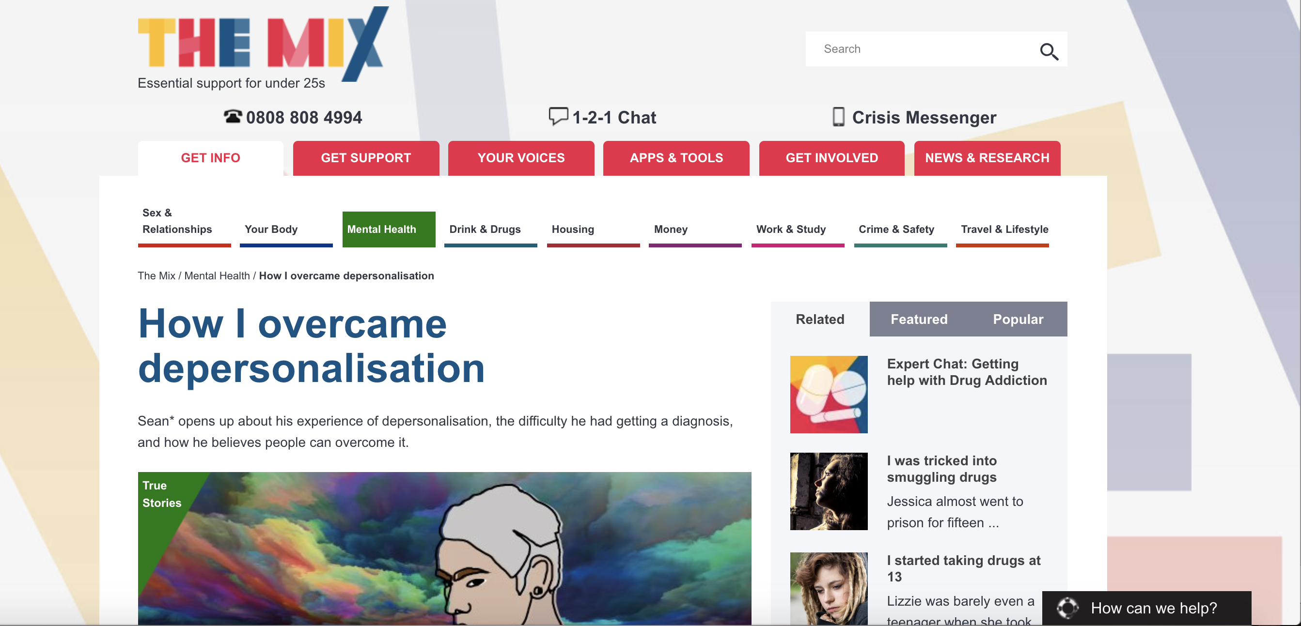
5 other people viewed this article in the last hour.
Notes:
We had several ideas on how to combat this – this included having live updates about other users interactions with articles example here is on this article 5 other users are currently reading the same piece

Slide 4
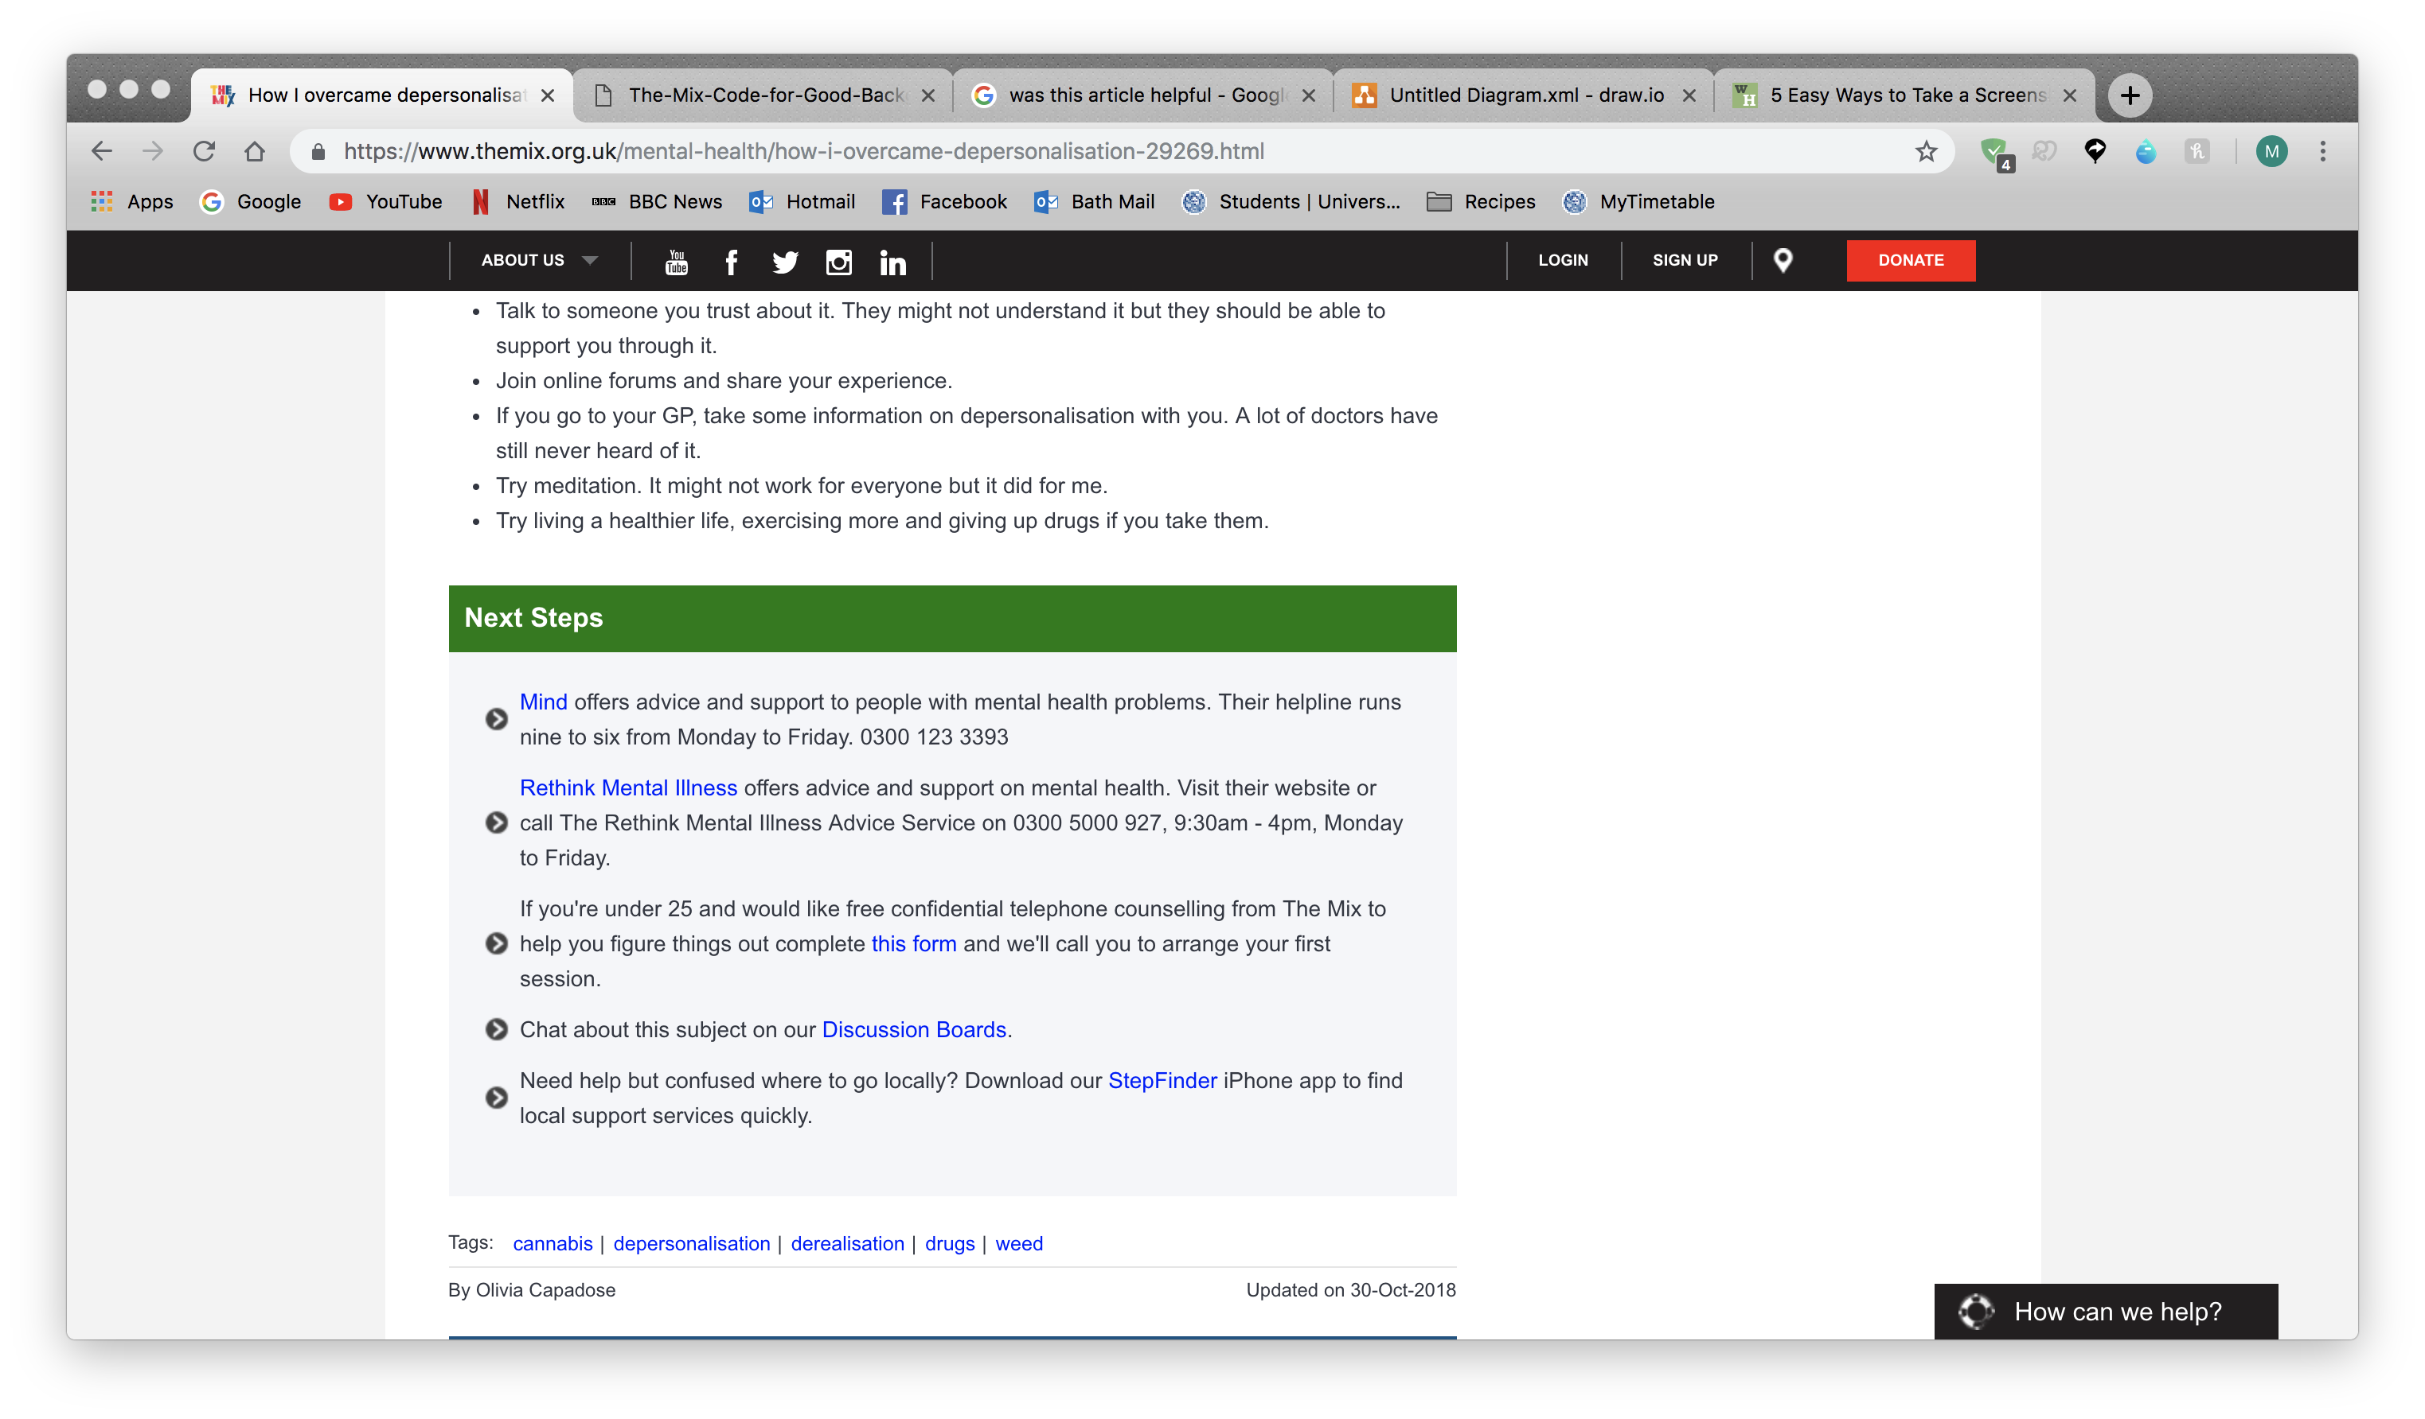
Yes
Was this article helpful?
No
Yes
Was this article helpful?
No
Notes:
Another thought was including an “exit survey” of sorts – this was just a simple yes or no question asking if the article helped with the users problems

Slide 5
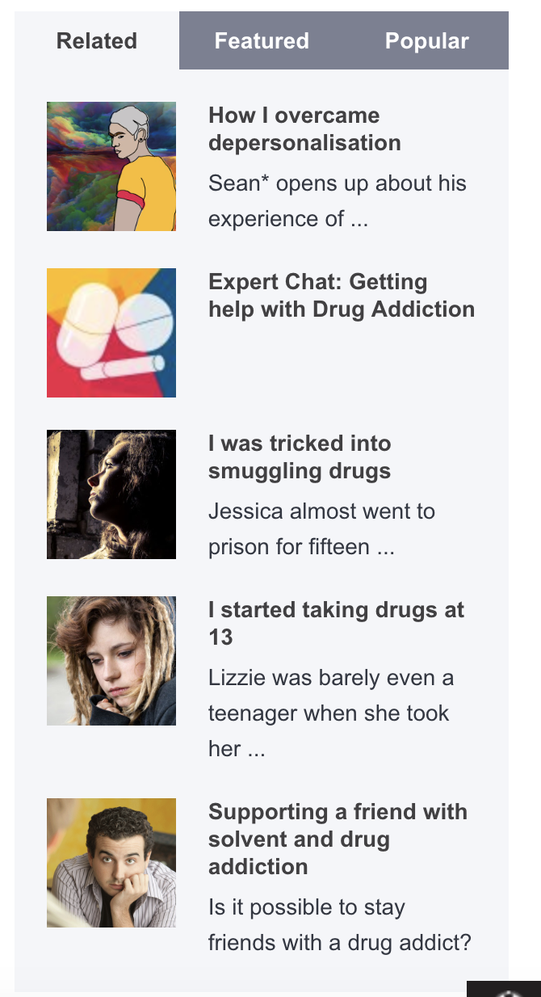
Recommended articles based on your previous searches
Yes
Was this article helpful?
No
Notes:
And to lead on from the exit survey we also wanted to try increases the amount of interaction each person had with the mix – by adding in a recommended article based on previous searches using cookies to keep the user browsing
Gather information

Slide 6
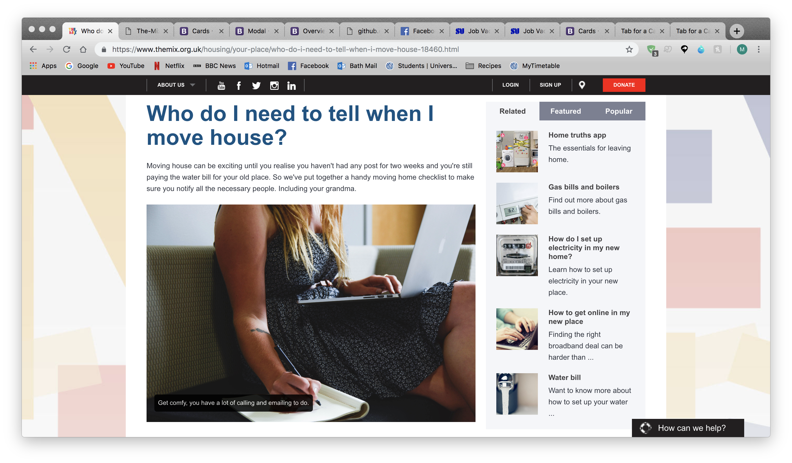
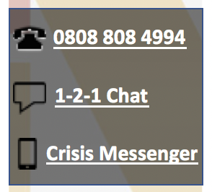
0808 808 4994
1-2-1 Chat
Crisis Messenger

Slide 7
This slide is for demoing the chat bot when user first enters site
Notes:
The idea we decided to implement was creating a chat bot to find out more about the user from when they first enter the site – it asks the person about how they are feeling and what their issue is. This leads to a messaging box between the chat bot and user which in turn leads to the bot recommending other services found through the website

Slide 8
This slide is for showing off the matching to other users with similar problems allows these users to not feel alone
Notes:
As an addition to this chat bot there is also now a functionality which matches users with similar problems and allows them to connect if they wish

Slide 9
Future Work for 1-1 Pairing
Improve 1-1 pairing algorithm
Expand 1-1 to group chat
Mobile integration

Slide 10
Future work for User Integration

